Slide 2
In Ground Kitchen Wastewater Treatment System
Automated Control of Fats, Oils & Grease (FOGs)
Designed to Service Restaurants
Ron Panter
CEO
Sustainable Environmental Technologies, Inc. (SET, Inc)
Technology Licensed from PMC Environmental Technologies, LLC

Slide 3
AGIS System
Proven Technology currently in use at several McDonalds locations in Michigan
Other non McDonald locations include:
Brookwood Golf Club – Burton MI.
Sagebrush Cantina – Fenton MI.
End result “gray water” – discharge to public sanitary
treatment facility.

Slide 4
Advanced Grease Interceptor System (AGIS)
A PROVEN WAY TO MANAGE FOG’s
In 2006, half of all sanitary sewer overflows (10,000) in the US were directly or indirectly related to build ups of retained fats, oils, and grease in sewer lines.
By reducing fats, oils, and grease going into the sewers AGIS helps to protect our waterways from sanitary sewer overflows.
Control of water pollution is of vital interest to everyone.

Slide 5
FOGs in Restaurant Wastewater
EPA’s Best Practice for FOGs - TRAP & TRANSPORT
Wastewater FOGs are Difficult:
TO TRAP – Grease Trap Effluent Never
Meets Discharge Standard
TO MONITOR – Grease Traps Fill with No
Economic Incentive for Dumping
TO DUMP – Legal Treatment of FOG Waste is
Expensive.
TO ENFORCE – Large Number of Restaurants
and Small Number of Staff

Slide 6
Best Practice Using AGIS
AGIS Traps & Treats FOGs at the source
AGIS consumes FOGs prior to discharge.
AGIS offers an optional ability to collect and store process data.

Slide 7
AGIS Design Features
Automated systems operation fosters continuous replication of initial inoculation.
AGIS does not require any additional additives.
AGIS does not require pump outs of the Grease Trap.
AGIS signals management if system has a problem.
All Micro Organisms are non-pathogenic and approved by the US Environmental Protection Agency.

Slide 8
McDonalds: Miller Road Flint, first demonstration of technology

Slide 9
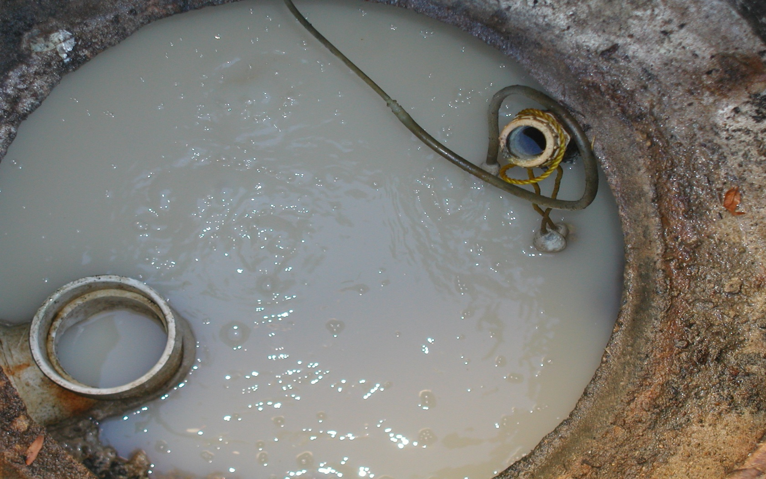
Miller Road Discharge Section After Twenty-Six Months

Slide 10
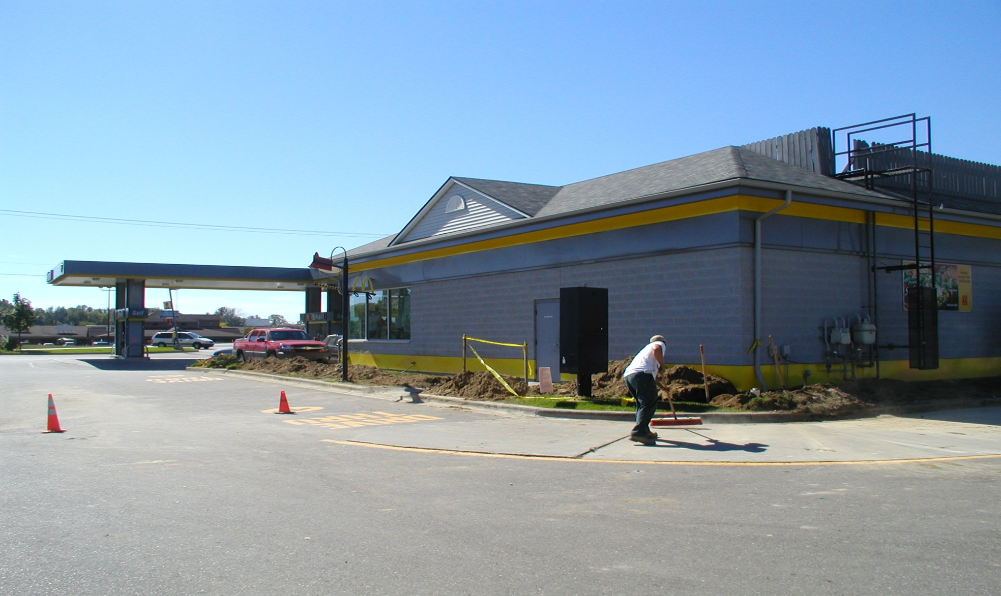
Installation September 2004 McDonalds on Thompson Road Fenton, Michigan

Slide 11
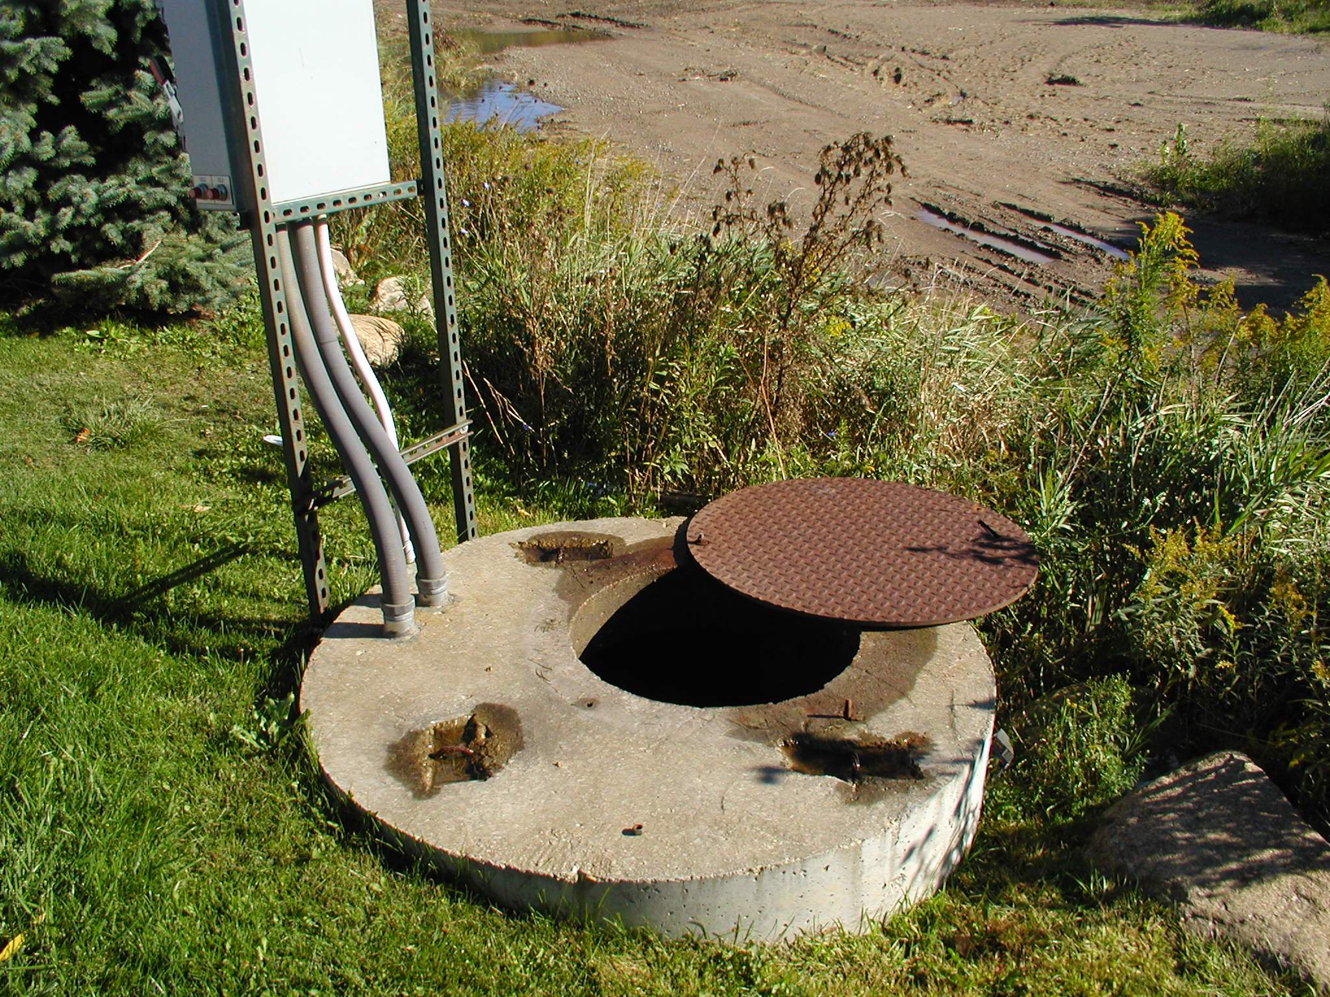
Thompson Road Lift Station

Slide 12
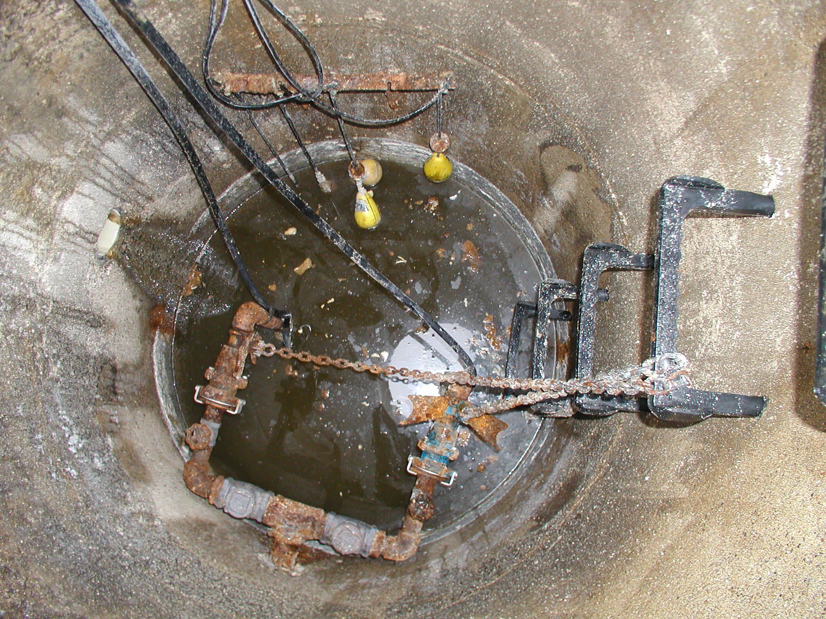
Thompson Road Lift Station Immediately After Installation

Slide 13
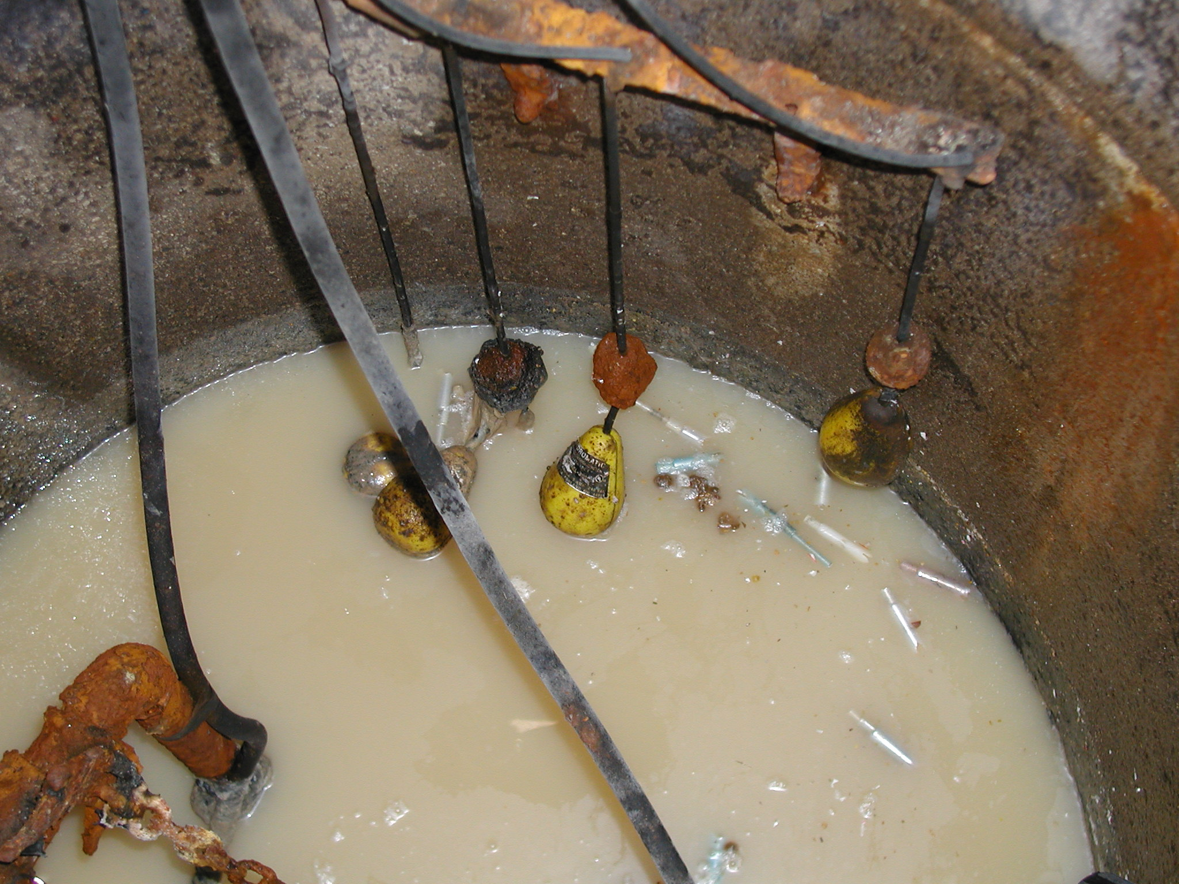
Thompson Road Lift Station After One Year No Solid Buildup

Slide 14
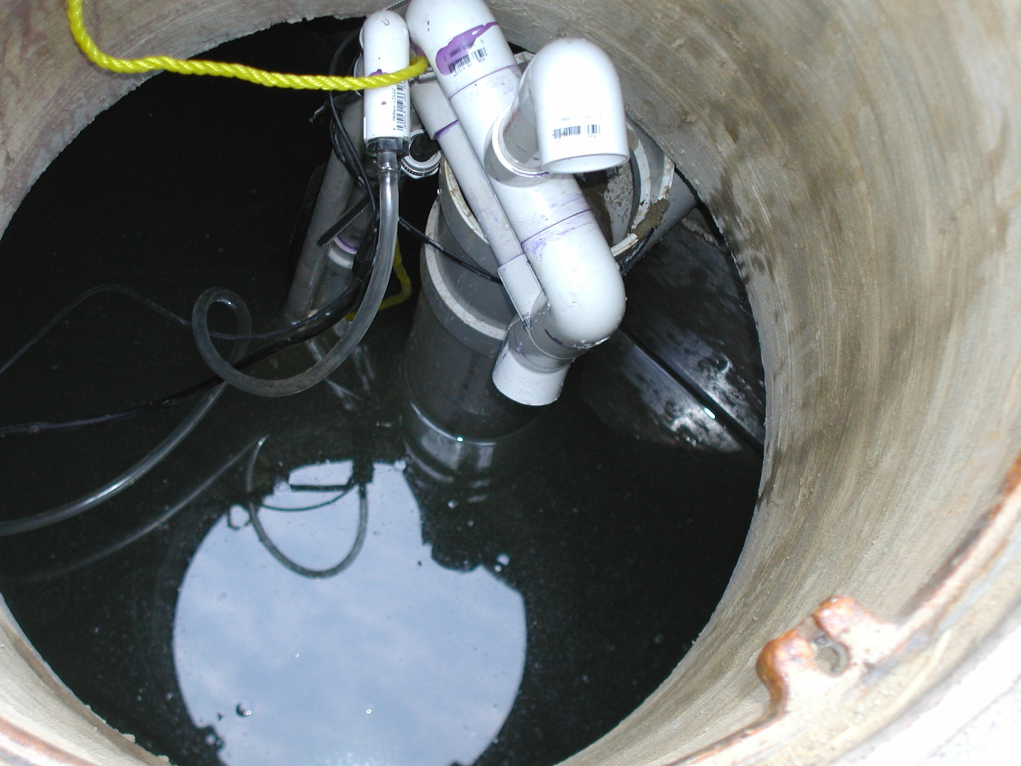
Warren, MI Outlet Section Prior To System Going Online

Slide 15
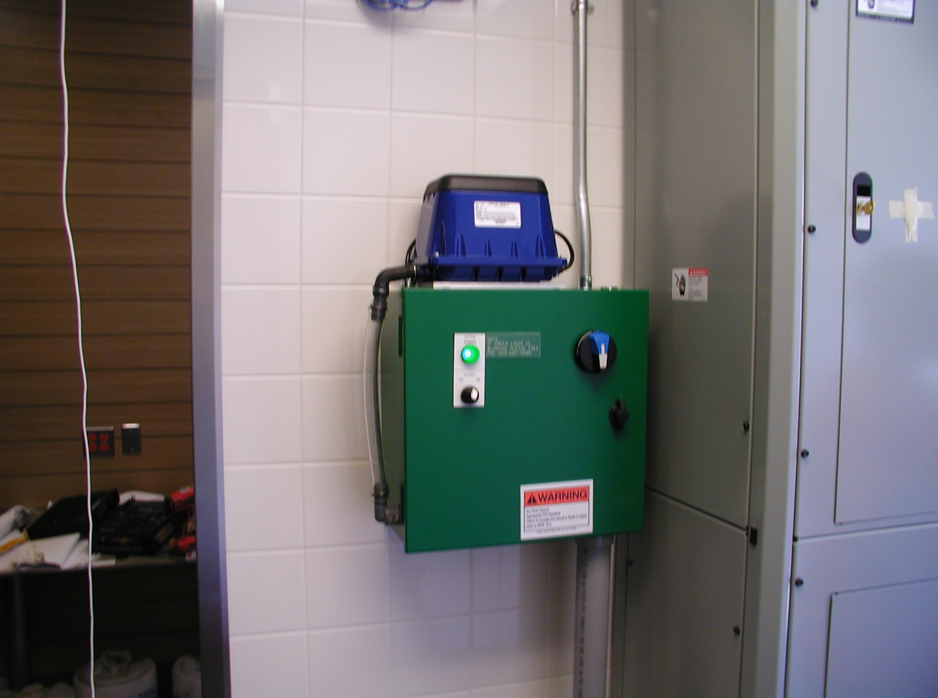
System Control Panel

Slide 16
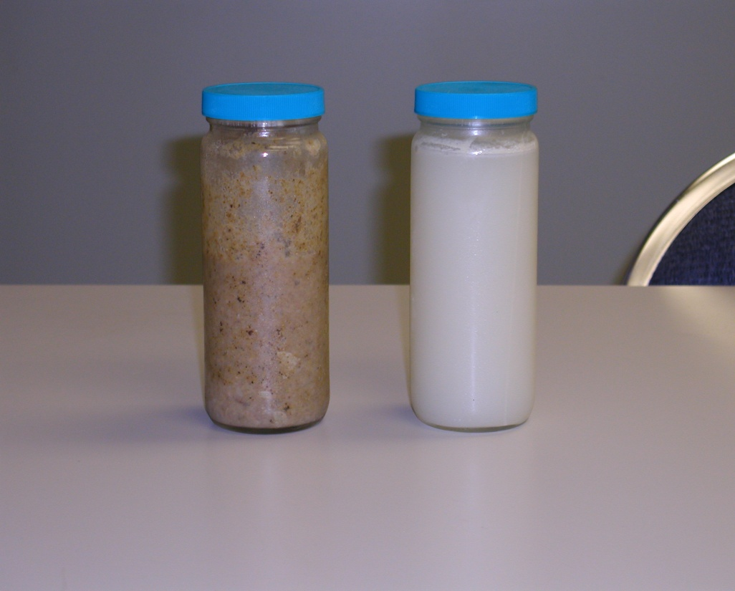
The Solution is a Tested and Proven Advanced Grease Interceptor System
Breakthrough product turning in ground grease traps into controlled Wastewater Treatment Systems
AGIS Reduces the percentage of Fats, Oils, and Grease in the discharge wastewater to less than 1 tenth of 1 percent.

Slide 17
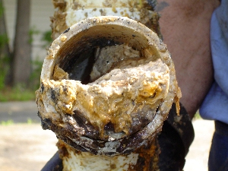
FOG Clogged Pipe

Slide 18
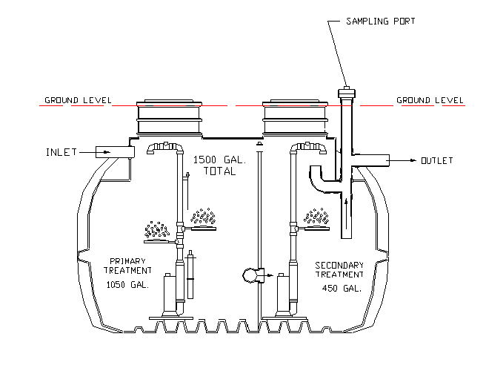
AGIS System Overview
Notes:
Grease Trap Section

Slide 19
PREVENTION PAYS
Accelerated reduction of FOG’s at source – consistent with best practice of pollution prevention theory, eliminate whenever possible and treat those wastes that can’t be eliminated as close to where the waste is produced as possible.
Adopters of AGIS technology will be supporting environmentally beneficial technology.
Reduces fines and surcharges for illegal discharges of
FOGs to sanitary sewer.

Slide 20
BENEFITS TO BUSINESS
Reduce Worker and Manager Involvement with FOGs.
Eliminates costs of pumping/hauling and disposing of FOGs.
Safer work environment – less slip and fall accidents, lifting
injuries and disposal issues.
Reduces business risk assessment for compliance issues,
fines, surcharges and clean up costs for improper disposal.
Good environmental citizen – state of the art treatment for
FOG wastes that are a necessary part of business.

Slide 21
Benefits To Sewer Lines
AGIS eliminates FOGs being discharged to sanitary
sewer lines and will reduce line maintenance.
AGIS will reduce pumping and lift station failures
AGIS will reduce sewer back-ups and untreated discharges to rivers and lakes
AGIS will allow for better maintenance of public
treatment facilities. There will be a shift back of staff
from line maintenance to facility maintenance.

Slide 22
AGIS - COSTS
Construction Costs - VARY BY SITE
All costs stated are McDonalds of Michigan negotiated prices
AGIS Polytank System Cost is $16,118.00
All costs are subject to local sales taxes per state
FOB Mount Morris, MI

Slide 23
Thank You
Contact information:
Ron Panter
CEO
Sustainable Environmental Technologies, Inc.
810-687-5600 Office
810-577-1299 Cell
rpanter@pmcworks.com

